Slide 1
Online EHS Training
Hydrogen Sulfide (H₂S) Safety Awareness
EHS 2023

Slide 2
Course Objective
Upon completion of this training course, participants will be able to:
Understand the characteristics of H₂S.
Explain the H₂S exposure limits.
Describe the adverse health effects of H₂S.
Highlight the safety precautions to take when working in an H₂S Environment.

Slide 3
General Properties of H₂S
Hydrogen Sulfide (H₂S) is an extremely toxic gas that is colorless, flammable, heavier than air, soluble in water and oil.
Has an offensive odor similar to rotten eggs at low concentration, at higher concentrations it rapidly deadens the sense of smell.
A poisonous gas that can paralyze the breathing system and can kill in minutes.
Belongs to the inorganic Sulfide family.
When burning, H₂S produces a Sulfur Dioxide (SO₂) blue flame, this gas is also extremely toxic and has a pungent smell.

Slide 4
Formation of H₂S
H₂S develops naturally in oxygen deficient environments, such as bogs, swamps, polluted water, and manure pits. It can be also generated as a common by-product of industrial processes such as; oil and gas reservoirs, sewage processing facilities and research laboratories.
Stink Damp
Hydrogen Sulfide
Rotten-Egg Gas
Sour Crude / Sour Gas
Swamp Gas
H₂S
Sewer Gas
Dihydrogen Sulfide
Hydrosulphuric Acid
Hepatic Gas
Sulphurated Hydrogen
Devil’s breath

Slide 5
Health Hazards of H₂S
When inhaled, H₂S will enter through the lungs and is considered a chemical asphyxiate.
It blocks O₂ from bonding to red blood cells causing oxygen deprivation. H₂S is also transported to the brain and attacks the respiratory control center.
H₂S can have an array of health effects on the body depending on exposure concentrations. At high concentrations, H₂S can kill in a single breath.
Concentration | Health Effects of H₂S
10 ppm | Beginning eye irritation
27 ppm | Strong unpleasant odor, but not intolerable.
50-100 ppm | Slight respiratory tract irritation after 1 hour exposure.
100 ppm | Coughing, eye irritation, loss of sense of smell after 2-15 minutes. Altered respiration, pain in the eyes, and drowsiness after 15-30 minutes followed by throat irritation after 1 hour. Several hours exposure results in gradual increase in severity of these symptoms and death may occur within the next 48 hours
200-300 ppm | Severe respiratory tract irritation after 1 hour of exposure. Possible pulmonary edema (fluid in the lungs).
500-700 ppm | Loss of consciousness and possibly death in 30 minutes to 1 hour.
700-1,000 ppm | Rapid unconsciousness, loss of respiration, and death after 1-3 minutes.
1,000-2,000ppm | Unconsciousness at once, loss of respiration and death in a few minutes. Death may occur even if individual is removed to fresh air at once.

Slide 6
Symptoms of H₂S Exposure
Eye irritation
Fatigue
Throat irritation
Skin irritation
Headache
Nausea
Dizziness
Loss of consciousness
Vomiting
Irrational behavior
Coughing
Excitement

Slide 7
Exposure Limits of H₂S
Permissible Exposure Limit (PEL) for an 8-hr period average: 10 ppm*.
Short Term Exposure Limit (STEL) for a 15-minute average: 15 ppm.
Immediately Dangerous to Life or Health (IDLH): 100 ppm
WARNING!!!
You cannot rely on your sense of smell to tell how much H₂S is present….
* Note: ppm stands for parts per million, which equals to 0.00010 percent (%)

Slide 8
Safety Precautions for H₂S Environment
Warning signs are to be posted when H₂S gas may be present.
H₂S gas detectors (either personal/portable or fixed) with an alarm system should be available and used.
At elevated possible concentrations, the involved team are to be trained on the use of breathing equipment, its location for use in an emergency and first aid techniques.
Work should be carried out under a supervision of competent and trained person following the buddy system.
If detector alarm sounds, site occupants must evacuate promptly the building to the nearest assembly point. Protect yourself first. Don’t become another victim.
When work in environments with more than 10 ppm H₂S (continues), it is recommended to use one of the common Breathing Apparatus; Self-Contained Breathing Apparatus (SCBA) OR Supplied Air Respirator (SAR).
Remember, NO job is so important and NO service is so urgent that we cannot take time to perform our work SAFELY “SAFETY FIRST”...

Slide 9
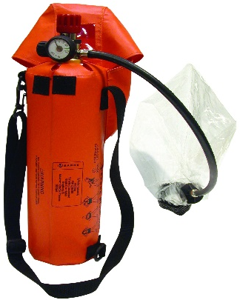
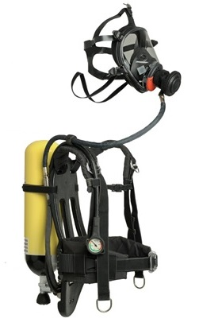
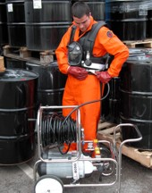
Breathing Apparatus (Respiratory Protection)
Emergency Escape Breathing Device ‎(EEBD)
Contains breathing air for a time period of approximately 15 minutes, along with a low pressure audible alarm. It can be used during hazardous conditions such as fire, smoke, poisonous gases in order to rapidly rescue of the casualty or/and take a prompt corrective action (e.g. closing a valve, turn off all electrical equipment, shut off the fuel supply…etc.).
Self-Contained Breathing Apparatus (SCBA)
This type of apparatus provides air from a cylinder worn on the back. A commonly used cylinder will supply air for 30 minutes while the wearer is engaged in heavy physical work. Other cylinders are available for longer or shorter usage. Duration of air supply is dependent on the type of work performed and the individual’s physical condition. Required Training to Use.
Supplied Air Respirator (SAR)
Also known as air-line respirators. Supply air to a facepiece via a supply line from a stationary source. SARs are available in positive-pressure and negative-pressure modes. Pressure-demand SARs with escape provisions provide the highest level of protection. SARs are not recommended for entry into IDLH atmospheres unless the apparatus is equipped with a SCBA unit. Required Training to Use.
EEBD
SCBA
SAR

